Slide 1
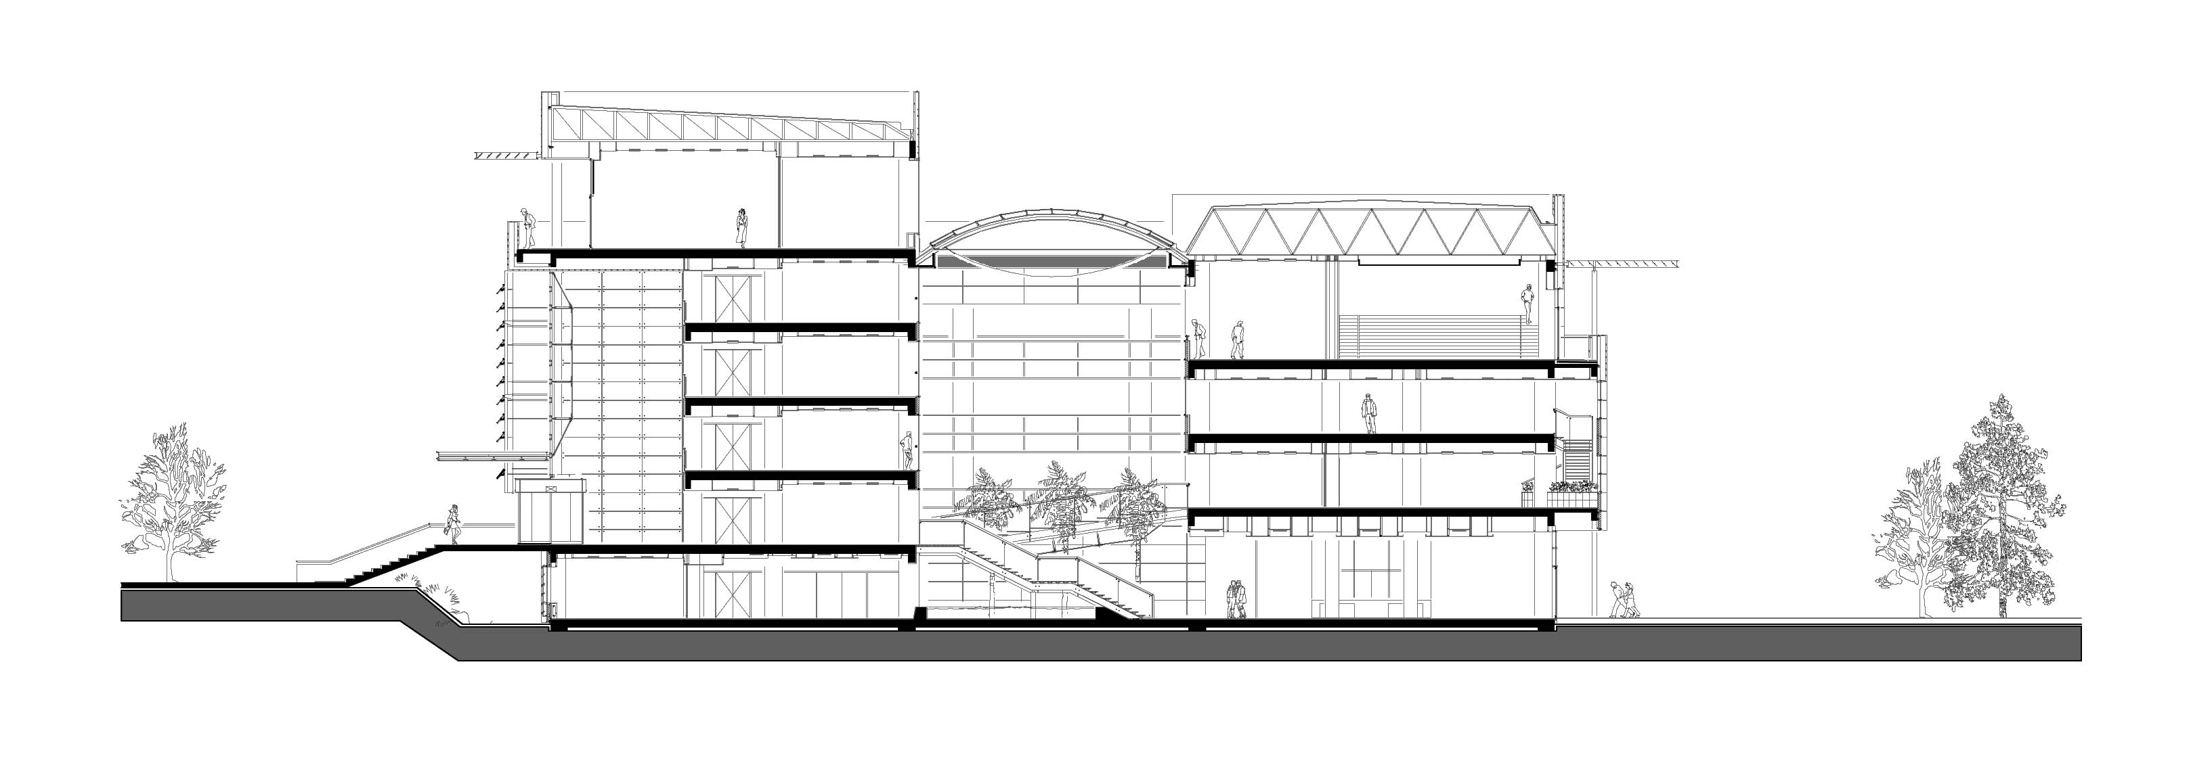
TOBB University of Economics and Technology

Slide 2
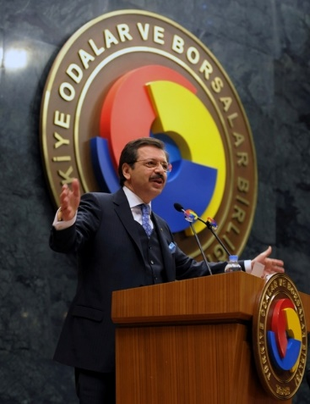
About TOBB ETÜ
TOBB ETÜ,
Founded by the Education and Culture Foundation of the Chambers and Commodity Exchanges of Turkey (TOBEV),
With the support of the Union of Chambers and Commodity Exchanges of Turkey (TOBB),
Established in 2003 and started education and training in 2004 in Ankara, Turkey.
Notes:
TOBB Kısmı Not: TOBB represents the largest non-profit business organization in Turkey, covering 365 Chambers and Commodity Exchanges and representing 2 million companies. The current president of TOBB, M.Rifat Hisarcıklıoğlu, was elected as the President of TOBB in 2001 and was re-elected respectively in 2002, 2005, 2009 and 2013.

Slide 3
History
2001
2002
2003
2004
Official establishment of TOBEV, the founder of TOBB ETÜ
TOBEV’s decision to establish TOBB ETÜ
The Grand National Assembly’s passing of the Law on TOBB ETÜ’s establishment
Admission of the first students, with
3 faculties and 6 departments
2009
2008
2007
2006
2005
-Opening of the Foreign Languages Building
-Establishment of the Faculty of Law
TOBB ETÜ’s first graduation ceremony
Establishment of the Faculty of Architecture &Design
TOBB ETÜ began its first Co-op term with 149 students
Admission of the first postgraduate students
2010
2013
2014
2016
2019
Opening of TOBB ETÜ Student Guesthouse
-Establishment of the Faculty of Medicine
-Opening of TOBB ETÜ Technology Center
Opening of the Morphology Laboratory of the Faculty of Medicine
TOBB ETÜ Private Hospital’s association with TOBB ETÜ
Rearrangement of AOÇ terrain.
Notes:
2004: 3 Faculties: Engineering, Economics and Social Sciences, Science and Literature İktisadi ve İdari Bilimler (İİBF), Fen Edebiyat (FEF)
6 Departments: MÜH: Computer Eng., Electrical and Electronics Eng., Mechanical Eng. İİBF: Economics, Management FEF: Mathematics

Slide 4
TOBB ETÜ from 2004 to 2023
2004
270 Students
35 Teaching Staff
2023
5.605 Students
348 Teaching Staff
3 Faculties
6 Depart.
6 Faculties 4 Institutes
22 Dept.
0
Alumni
10.941 Alumni
17 Tennure Track
226 Tennure Track
Faculties and Student #
Faculty of Engineering: 1.826
Faculty of Econ. and Administ. Sciences: 534
Faculty of Architecture and Design: 733
Faculty of Science and Literature: 361
Faculty of Law: 413
Faculty of Medicine: 262
+
Department of Foreign Languages: 1.021
Institutes and Student #
Doctorate (11 Progr.)
Master’s Degree (22 Progr.)
Grad Sch. of Engineering and Science
Master’s: 188
Doct.: 68
Grad. Sch.of Economics and Social Sci. Master’s: 179
Doct.: 16
Grad. Sch. of Health Sci.
Master’s: 1
Doct.: 3
Notes:
14.11.2023 tarihinde güncellenmiştir.
Toplam Öğrenci Sayısı: 5.605
Lisans: 5.150
YL: 368
DR: 87
Toplam Mezun: 10.941
Lisans: 9.222
YL: 1.626
DR: 93

Slide 5
Programs Undergraduate Programs
Faculty of Engineering
Computer Engineering
Biomedical Engineering
Faculty of Economics and Social Sciences
Economics
Management
Faculty of Science and Literature
Faculty of Architecture and Design
Faculty of Law
Faculty of Medicine
Electrical and Electronics Engineering
Industrial Engineering
Mechanical Engineering
Material Science and Nanotechnology Engineering
Political Science and International Relations
International Entrepreneurship
Mathematics
Psychology
History
English Lang. and Literature
Turkish Lang. and Literature
Industrial Design
Visual Communication Design
Interior Arch. and Env. Design
Architecture
Artificial Intelligence Engineering

Slide 6
Programs Postgraduate Programs
Graduate School of Engineering and Science
Graduate School of Economics and Social Sciences
Master’s Programs
Economics
Management
International Relations
Turkish Lang. and Literature
Design Studies
Security Studies
Migration Studies
Public Law
Private Law
History
Applied Economics and Finance
Clinical Psychology
Doctorate Programs
Political Science and International Rel.
Economics
Finance
Master’s and Doctorate Programs
Electrical and Electronics Engineering
Computer Engineering
Biomedical Engineering
Industrial Engineering
Mechanical Engineering
Micro -Nanotechnology Engineering
Mathematics
Master’s Programs
Architecture
Cyber Security
Graduate School of Medical Sciences
Graduate School of Educational Sciences
Master’s and Doctorate Programs
Molecular Sciences

Slide 7
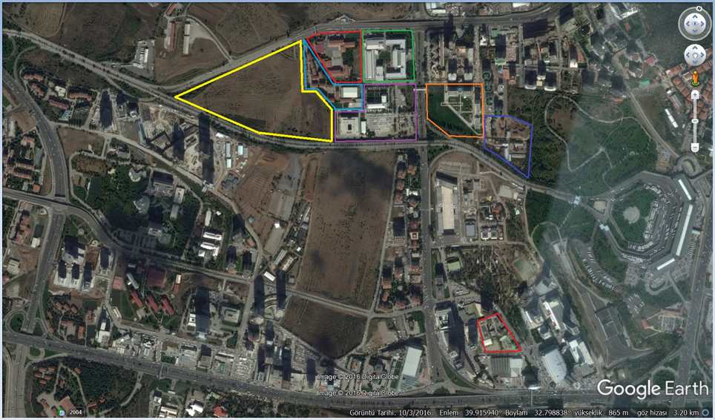
TOBB ETÜ Campus
TOBB ETÜ Main Campus
TOBB ETÜ Hospital

Slide 8
TOBB ETÜ in World Rankings
Rankings |  | TOBB ETÜ’s Ranking | Number of Universities | Number of Turkish Universities
 | Times Higher Education (THE) Young University Rankings 2023 | 401-500 | 605 | 47
 | Times Higher Education (THE) Emerging Economies 2023 | 501+ | 698 | 54
 | Times Higher Education (THE) World University Rankings 2024 | 1001-1200 | 1904 | 75
 | Times Higher Education (THE) Asia University Rankings 2023 | 401-500 | 669 | 61
 | QS Emerging Europe and Central Asia Rankings (EECA) 2023 | 221-230 | 449 | 63
 | Greenmetric Global University Rankings 2022 | 600 | 1050 | 83
Notes:
14.11.2023 tarihinde KSO ile güncellenmiştir.

Slide 9
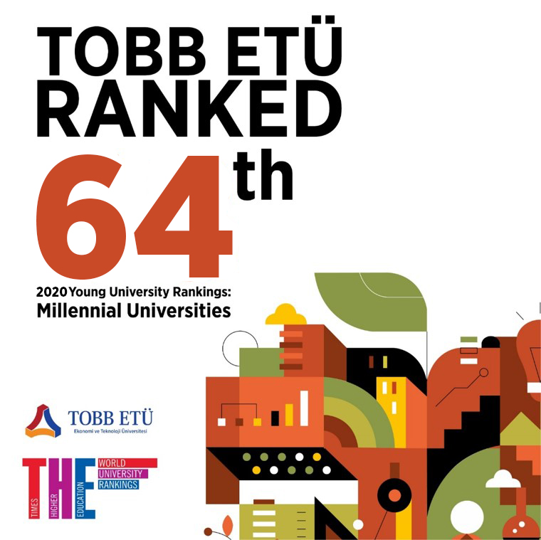
Times Higher Education (THE) Young University Rankings 2020: Millennial Universities
Times Higher Education (THE) is accepted as one of the most prestigious university rankings in the world.
TOBB ETÜ ranked 64th in THE’s Young University Rankings 2020: Millennial Universities which lists the best universities in the world founded since the year 2000.
Notes:
En son 2020 yılında bu sıralama yayınlanmıştır, 2020 sonrası Milenyum sıralaması bulunmamaktadır.

Slide 10
Why is TOBB ETÜ different?
First and Only Cooperative Education in Turkey
3-Term Education System
Double Major Degrees and Minor Programs
Mandatory Second Language
Success in the World University Rankings
English Preparatory Class and TOEFL Exam

Slide 11
Cooperative Education at TOBB ETÜ
At TOBB ETÜ, students attend the co-op program 3 times, each lasting 3,5 months at a workplace, as full-time, paid and insured employees.
University- business world coopeation
Well equiped work force for workplaces
Ability to transform theory to practice
Career plan prior to graduation
Values

Slide 12
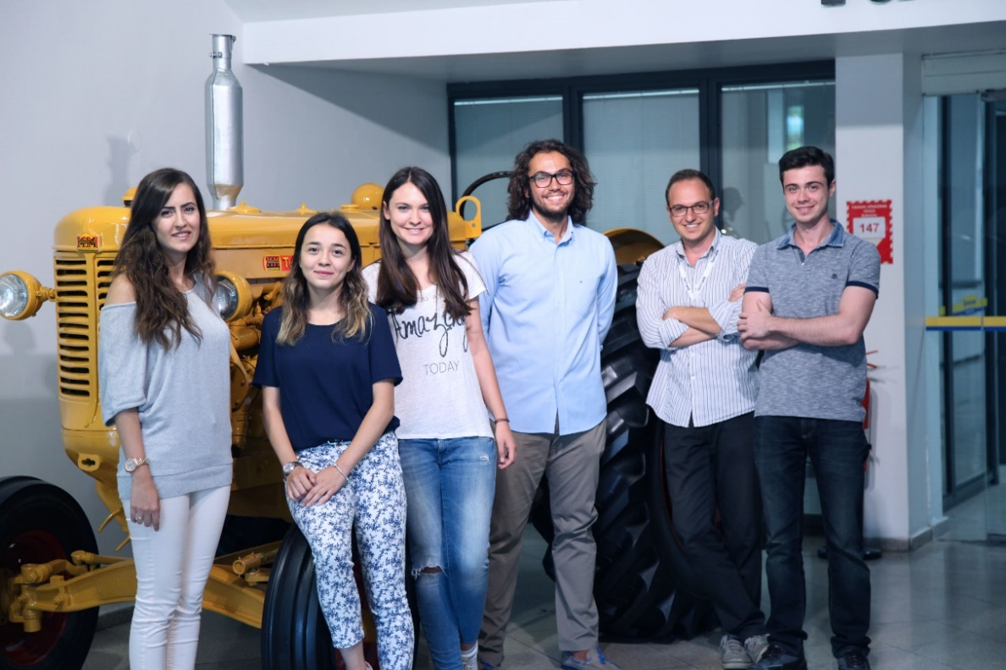
Cooperative Education at TOBB ETÜ
Co-Op Education is a unique approach to higher education which;
is implemented for the first time by TOBB ETÜ in Turkey,
aims to provide students with work experience prior to graduation,
is based on the principle of university-industry cooperation.
Cooperative Education is mandatory in all departments of TOBB ETÜ except the School of Medicine.

Slide 13
3-Term Education System
At TOBB ETÜ, each education year is divided into three equal parts: Fall, Spring and Summer
3 Term Education System is not practiced in any other university in Turkey.
Term | Fall | Spring | Summer
1st Year | 1st Term | 2nd Term | 3rd Term
2nd Year | 4th Term | 5th Term | Cooperative Education (1)
3rd Year | 6th Term | Cooperative Education (2) | 7th Term
4th Year | Cooperative Education (3) | 8th Term | -
8 education terms
3 coop. education terms
Notes:
*TOBB ETÜ Students obtain their degrees earlier than their peers.

Slide 14
Cooperative Education in Numbers
# of Total Students: 28.816
Turkey: 27.623
Worldwide: 1.160
Turkey/Abroad: 33
Number of Students

Slide 15
Cooperative Education in Numbers Contracted Companies and Institutions
# of Contracted Companies and Institutions: 4.702
Turkey: 4.686
Abroad: 16
Notes:
14.11.2023 tarihinde, OEKGM verileri ile güncellenmiştir.
02.11.2022 tarihinde, OEKGM verileri ile güncellenmiştir.
Toplam Anlaşmalı Firma ve Kuruluşlar: 4371
Toplam Türkiye Anlaşmalı Firma ve Kuruluşlar: 4355
Toplam Yurtdışı Anlaşmalı Firma ve Kuruluşlar: 16 Erasmus Firması:255
2022 Yılında Protokol İmzalanan Kurum Sayısı: 362
22 Kasım 2021 OEKGM tarafından iletilen veriler ile güncellenmiştir.
Anlaşmalı Firma ve Kuruluşlar: 4017
Türkiye Anlaşmalı Firma ve Kuruluşlar: 4002
Yurtdışı Anlaşmalı Firma ve Kuruluşlar: 15 Erasmus: 220 (Sistemde kayıtlı olan Erasmus firma sayısı)
2021 Yılında Protokol İmzalanan Kurum Sayısı: 340

Slide 16
Cooperative Education in Numbers Contracted Companies and Institutions
Notes:
2023 yılı anlaşma imzalanan firma sayısı 331 (13.11.2023 OEKGM verileri)
2022 yılı anlaşma imzalanan firma sayısı 362. (02.11.2022 OEKGM verileri)
2021 Yılı anlaşma imzalanan firma sayısı 340. (22.11.2021 OEKGM verileri)
2020 Yılı anlaşma imzalanan firma sayısı 213. (23.10.2020 OEKGM verileri)

Slide 17
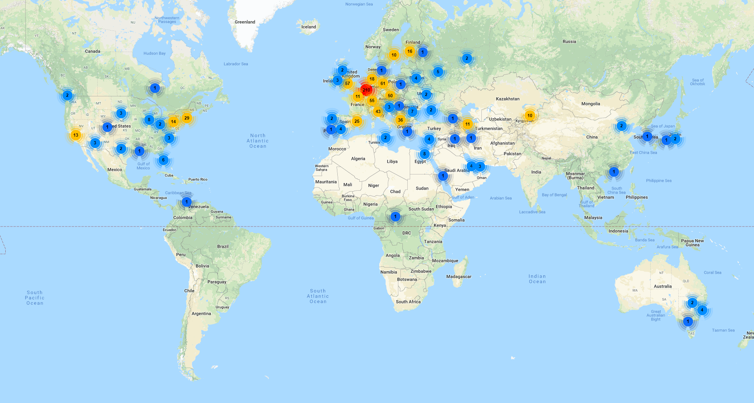
Cooperative Education Abroad 6 continents, 56 countries
Notes:
*788 students; 56 countries; 378 institutions and companies

Slide 18
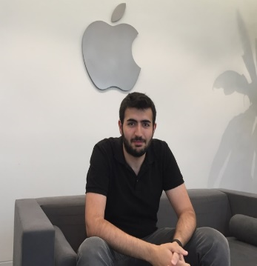
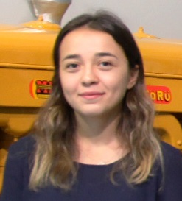
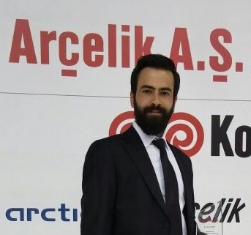
Our Co-op Success Stories
Defne Görgün Biomedical Engineering
Stanford University, USA
Volkan Keleş
Computer Engineering
Apple, USA
Hilal Kesemen
Economics
Türk Traktör, Turkey
Elif Büşra Kaya
Law Faculty
Michigan State Uni.,USA
Anıl Yeşil
Mechanical Engineering
Arçelik, Turkey
Burcu Yılmaz
Material Sc. &Nanotech
KAIST, South Korea

Slide 19
Double Major Degrees and Minor Programs Expertise in not one but two disciplines
# of Double Major Graduates: 316
# of Minor Programs Graduates: 143
Double Major
Minor
Notes:
Akademik yılların Güz Dönemi esas alınarak güncellenmektedir.
Son güncelleme: 16.11.2023

Slide 20
English and Second Foreign Language
French
German
Russian
Italian
Japanese
Chinese
Arabic
Spanish
English Education
1040 hours during the English prepatory education
The most rigorous training of English education in Turkey
Based on an international certification, TOEFL
Mandatory Second Foreign Language

Slide 21
Scholarships
TOBB ETÜ offers a variety of scholarship packages, which consists of tuition fee remission, accomodation opportunity, and a monthly stipend
Equivalent % of Students with Full Scholarship in 2023-2024: %39
Paid
Full Scholarship
Notes:
Akademik yılların Güz Dönemi esas alınarak güncellenmektedir.
Güncelleme: 16.12.2023
Güncelleme: 02.11.2022
Güncelleme: 19.11.2021

Slide 22
Scholarships at a Glance
Our strong commitment to equality of opportunity in higher education together with academic and cultural diversity determine the way we develop our scholarship opportunities
Our Scholarships
First 100 Scholarship | Full Scholarship | Partial Scholarships (%50 Tuition Scholarships) | Academic Merit Scholarship | Science Olympics Scholarship| Athletic Scholarship
New Scholarships
Business and Industry Scholarship Programme
Beginning from the 2018-19 Academic Year, with the support of the Turkish industries and businesses, TOBB ETÜ is offering full scholarships for successful students living in Turkey and TRNC with limited financial opportunities.
Undergraduate Transfer Scholarship Programme
Scholarships for undergraduate students who wish to change their major degree, for those study both at TOBB ETÜ and other universities.
International Student Scholarship Programme
Scholarships for successful international students who wish to study at TOBB ETÜ.
Notes:
24.10.2022 tarihinde ÖİM’den gelen aşağıdaki bilgiler ile güncellenmiştir.
https://www.etu.edu.tr/tr/aday-ogrenci/burslar
Tam Burs
2022 Yükseköğretim Kurumları Sınavında (YKS) yerleştiği puan türlerinde, SAY, EA ve SÖZ puan türlerinde ilk 50.000 DİL puan türünde ilk 7.500 olan öğrenciler için konukevi ücretinde burs oranında indirim sağlanır.
2022 Yükseköğretim Kurumları Sınavında (YKS) yerleştiği puan türlerinde, SAY ve EA puan türünde ilk 10.000'e, SÖZ puan türünde ilk 5.000'e, DİL puan türünde ilk 2.500'e giremeyen tam burslu öğrenciler konukevinde %50 indirimli olarak konaklayacaktır.
Tam burslu kontenjana giren öğrencilere 1-10000 arası yaşam katkı payı ödenir
Kısmi Burslar
Yeni yerleşecek öğrenciler için kısımı burslar sadece %50'dir
Eğitim Başarı Bursu
Başarı Bursu kontenjanları dahilinde, takip eden 1 eğitim dönemi için öğrenim ücretinden muaf tutulabilirler.

Slide 23
Academic Staff
%76 of our academics obtained their doctorate degree from the U.S.

Slide 24
Academic Staff

Slide 25
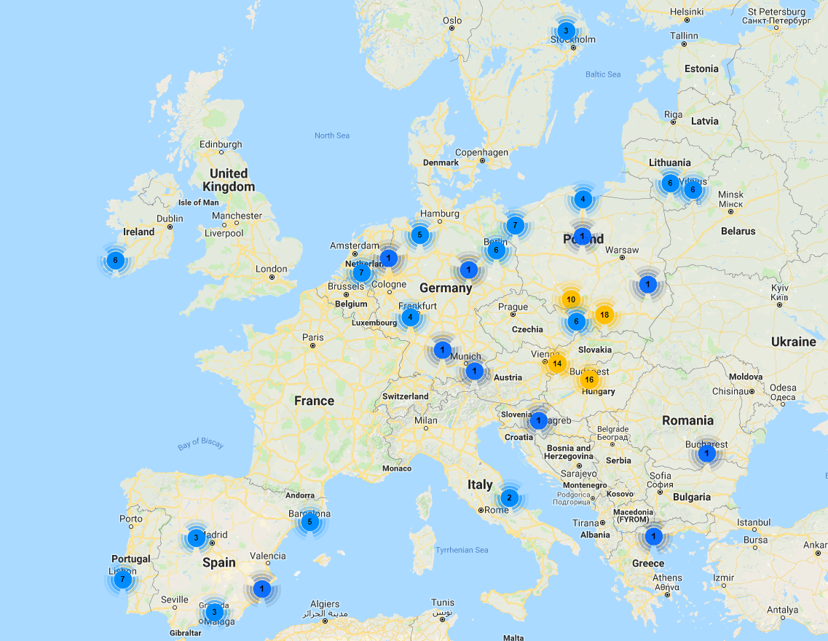
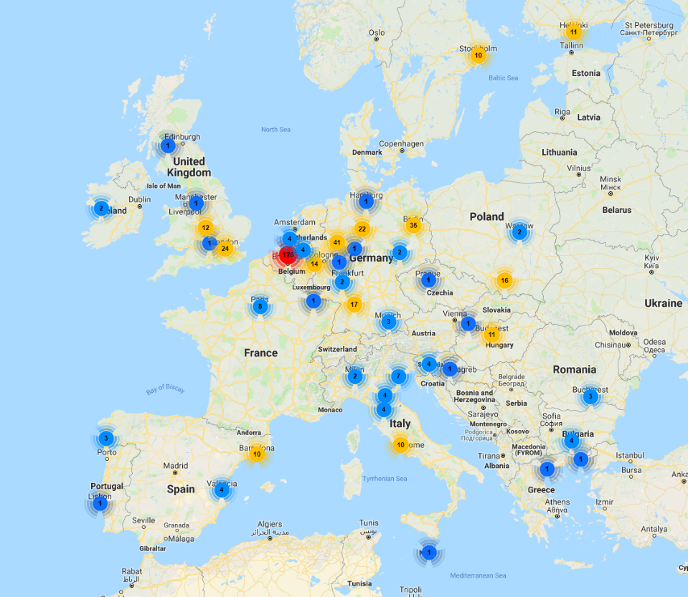
Exchange Programs
ERASMUS +
- Work experience abroad with full grant
Bilateral Agreements
- Cooperation with 64 Universities (Erasmus) and various other institutions
ERASMUS Education Mobility
ERASMUS Traineeship Mobility
Notes:
24.10.2022 tarihinde Dış İlişkiler Müdürlüğü verileri ile güncellenmiştir.

Slide 26
Research at TOBB ETÜ
74 Research Laboratories
37 Education Laboratories
13 Design Studios
Primary Research Areas
Energy
Defence
Industry
Medical
Information
Technologies

Slide 27
Research at TOBB ETÜ Indexed Scientific Publications and Projects
# of Indexed Scientific Publications : 5.302
# of Projects: 428 (ongoing and finalized)
*Beginning from TOBB ETÜ’s establishment
Academic and Scientific Project Budget
172.260.624,51 ₺
€ 3.874.664,72
$ 7.476.352,93
*Beginning from TOBB ETÜ’s establishment
Notes:
Endeksli Bilimsel Yayın Sayısı: 14.11.2023 tarihli Scopus verisi
Proje verileri: 14.11.2023 tarihli TTO verileri

Slide 28
Research at TOBB ETÜ Research and Implementation Centers
4. Medical Equipment Design Center (TOBB ETÜ MEDEC)
1. Energy Studies Research and Application Center
3. The Social Policy Research Center
5. Health Education Research and Application Center (TOBB ETÜ Hospital)
2. TOBB ETÜ Hydro Energy Research Center
6. Eurasian Studies Research and Application Center
7. Continuing Education Research and Application Center (TOBB ETÜ SEM)
8. Turkish Industrial Competition Research and Application Center
9. Turkish Language Teaching, Research and Application Center (TOBB ETÜ TÖMER)
10. Dispute Resolution Center (TOBB ETÜ UYUM)

Slide 29
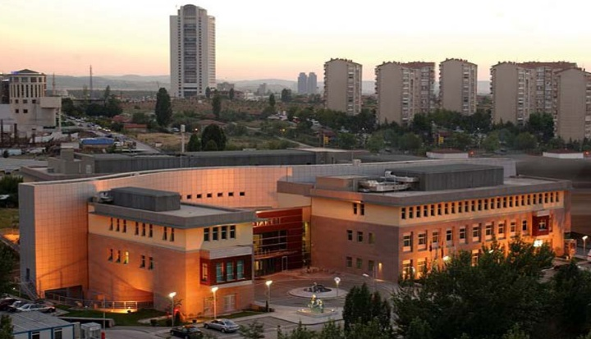
TOBB ETÜ Hospital
28 medical departments
More than 100 beds and 8 operating rooms
hastane.etu.edu.tr

Slide 30
TOBB ETÜ Hospital Development Project
As part of TOBB ETÜ Hospital’s recent development project, new units will be added to the existing structure.

Slide 31
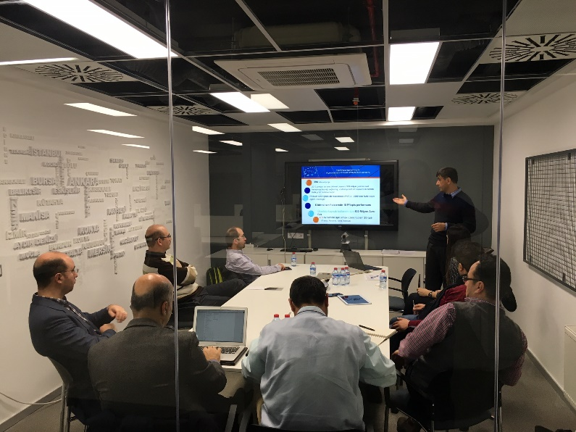
TOBB ETÜ Technology Transfer Office
Established in 2013 to enhance the technology transfer capacity and capabilities of TOBB ETÜ.
# of Total Patent Applications: 72
In Evaluation: 18
Accepted: 51
International Patent: 5
Project Management
Intellectual
and Industrial
Property Rights
Project
Development
Laboratory Services
Entrepreneurship
tto.etu.edu.tr
Notes:
14.11.2023 tarihinde TTO’dan alınan verilerle güncellendi.
02.11.2022 tarihinde TTO’dan alınan verilerle güncellendi.
Toplam Patent Başvurusu: 72
Değerlendirme Aşamasında: 18
Kabul Edilen: 51
Uluslararası Patent: 5

Slide 32
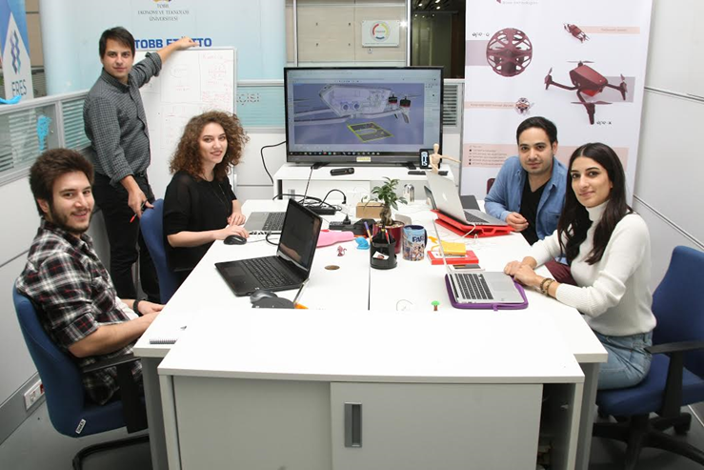
TOBB ETÜ GARAJ Entrepreneurship Center
TOBB ETÜ Garaj was established in 2013 to enhance the entrepreneurship ecosystem in Ankara.
Entrepreneurs
Universities
Relevant Public Institutions
Investors and Mentors
etugaraj.org
Notes:
*ApeDrone Dünyanın En İnovatif 20 Drone’u arasında

Slide 33
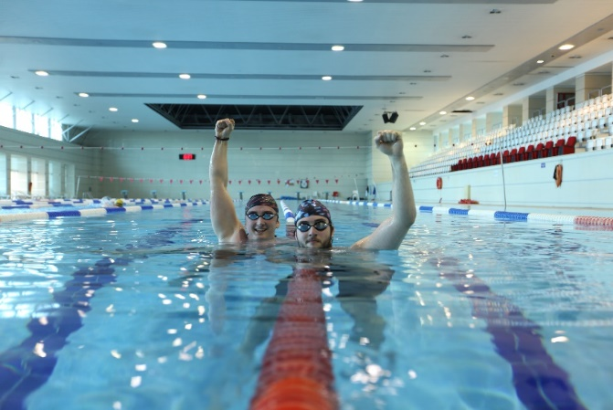
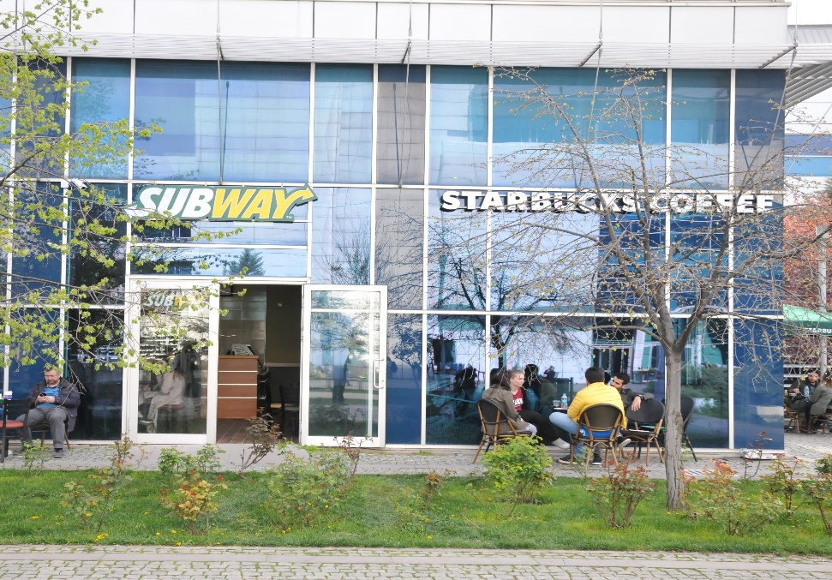
Life at TOBB ETÜ
Sports and Health Center
Dining Facilities
Free entrance to the Sports Center during specified periods of the day, for students
Variety of restaurants, bakeries and markets -Starbucks, Subway, Çatı- to meet our students’ expectations.
39

Slide 34
TOBB ETÜ GuestHouse
TOBB ETÜ Guest House has a capacity of 1.428 students
40
Notes:
Öğrenci konukevi yerleşke içinde, kız ve erkek öğrenciler için 4 blokta, 440 adet çift kişilik, 180 adet üç kişilik, 4 adet engelli odası olarak toplam 624 oda, 1428 yatak kapasitesine sahiptir.
Bütün odalarda banyo ve tuvalet, ısıtma / soğutma sistemi, buzdolabı, internet, telefon, elektronik kartlı giriş sistemi mevcuttur.
Her katta bulunan mutfak ve dinlenme / televizyon odası ortak alan olarak kullanılmaktadır.
Yatakhane girişinde yüz tanıma sistemli turnikeli kontrol vardır.
Konukevinde kafeterya, market, etüt alanları, bavul emanet odaları, çamaşırhane ile öğrencilere rahat bir ortamda yaşamaları sağlanmaktadır.

Slide 35
TOBB ETÜ Student Clubs
# of Student Societies: ~ 80
The first and only university social
network in Turkey for TOBB ETÜ students and graduates: ORTAM
topluluk.etu.edu.tr
41

Slide 36
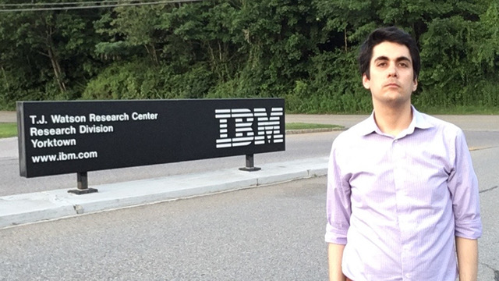
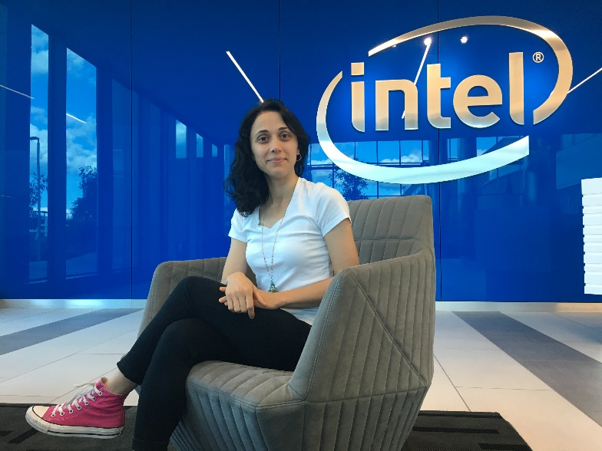
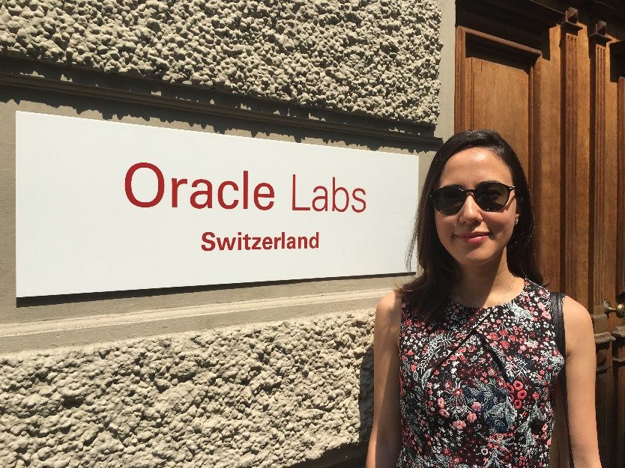
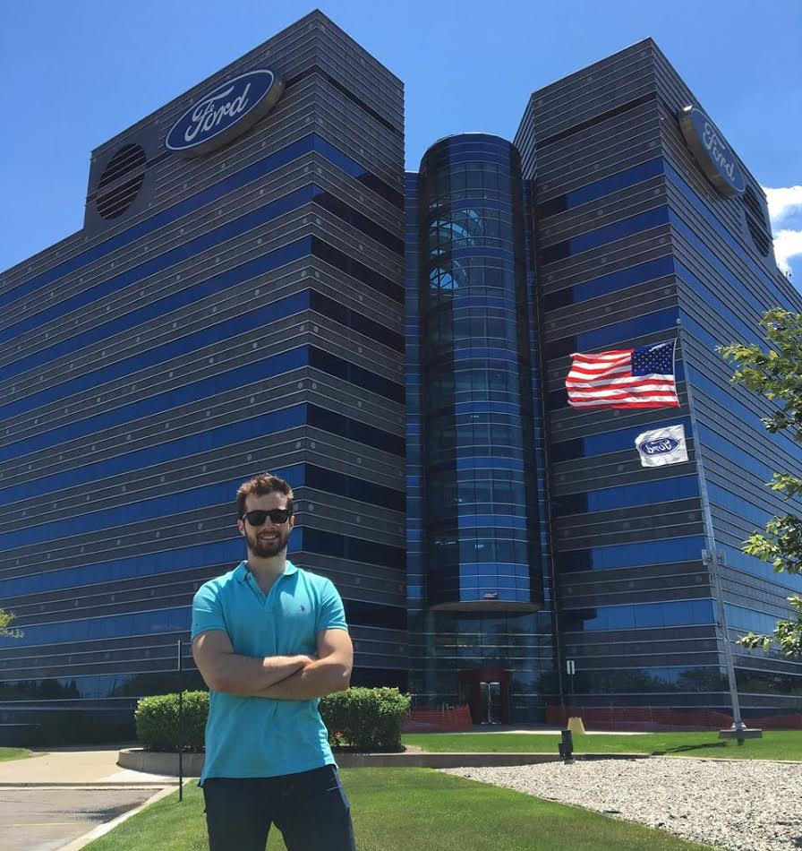
TOBB ETÜ Alumni
We are in constant contact with our Alumni and proud to have a regularly updated and growing alumni network worldwide.
42

Slide 37
TOBB University of Economics and Technology
www.etu.edu.tr
tobbetum
tobbetum
tobbetum
TOBB ETÜ

